Slide 1
Incidence of hypertension and its influencing factors
Hongtao Wu 602115507
Long Jin 602115510
Qianyu Qian 602115511
Wenda Li 602115515

Slide 2
Content
Problem statement
Background
How hypertension is formed
risk factors
High blood pressure related lifestyle
blood pressure
How to treat
Which patients need medication
Methods
Finding
Conclusion

Slide 3
Problem statement
To investigate the incidence of hypertension and its influencing factors in China

Slide 4
Background
Definition:
Hypertension (HTN or HT), also known as high blood pressure (HBP), is a long-term medical condition, Long-term high blood pressure, is a major risk factor for coronary artery disease, stroke, heart failure, chronic kidney disease, and dementia.

Slide 5
How hypertension is formed
Three basic elements of blood pressure formation:
heart
blood vessels
blood volume.

Slide 6
risk factors
Risk Factors:
age
genetic factors
environmental factors
unhealthy lifestyles

Slide 7
Hypertension related to genetic factors should be divided into two categories:
single-gene inherited hypertension
genetic polymorphism.

Slide 8

single-gene inherited hypertension:
It is caused by the occurrence of hypertension due to rare mutations of certain specific genes.
It has the characteristics of high blood pressure in adolescents and even children, and organ damage is more serious
rare among all hypertensive patients.

Slide 9
genetic polymorphism:
Gene polymorphism refers to the difference of genes in some non-critical positions
Among individuals with one or both parents who have hypertension, the incidence of hypertension is about twice the average.

Slide 10
High blood pressure related lifestyle:
Diet
Alcohol
Exercise
Emotions

Slide 11
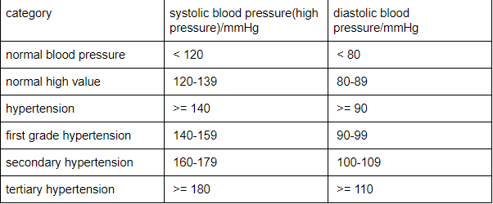
blood pressure

Slide 12
How to treat
Low
Low-salt and low-fat diet to control obesity
Moderate
Moderate exercise (at least 5 days per week, at least 30 minutes of moderate-intensity exercise each time);
Quit
Quit smoking, limit alcohol, calm the mind, eat more fresh vegetables and cereals.

Slide 13

Which patients need medication
Patients with hypertension grade 2 or above;
Hypertension combined with diabetes, or there have been damage or complications of target organs such as heart, brain and kidney;
Those whose blood pressure continues to rise and whose blood pressure has not been effectively controlled after improving their lifestyle.

Slide 14
Methods
1. Use unified design, unified form and unified standardized survey method:
the annual incidence of diagnosed hypertension was 1.20% for men and 1.07% for women, and 3.27% and 2.68% were critical and above, respectively.

Slide 15
2. Multiple regression analysis :
showed that the average level of systolic blood pressure (SBP), diastolic blood pressure (DBP) and body mass index at baseline had the most significant impact on the incidence of hypertension.

Slide 16
Finding
There are also obvious differences between the different occupations of work, agriculture and fishing, and different genders. In addition, between 35 and 59 years of age, the younger the age, the greater the increase in relative risk.

Slide 17
Conclusion:
Primary prevention of hypertension should be carried out as early as possible before the age of 35.

Slide 18
THANK YOU

